Slide 1
UNIT-II
Methods and classes

Slide 2
Unit – II | Contact Hours = 8 Hours
Methods and classes: methods, returning from a method, returning a value, using parameters, constructors, parameterized constructors, the new operator revisited, garbage collection and finalizers, this keyword, controlling access to class members, pass objects to methods, argument passing, returning objects, method overloading.

Slide 3
Methods
In Java, a method is a block of code that performs a specific task and can optionally return a value.
Methods are used to encapsulate and reuse code, making it easier to read and maintain. They can be defined within a class or interface and can be called by other parts of the program.
Methods can also take parameters, which are values passed to the method when it is called, and can have different access levels, such as public or private.
Methods are defined using the following syntax:
modifiers returnType methodName(parameter list) {
// method body
}

Slide 4
Adding the method to the class
To add a method to a class in Java, the method must be defined within the class using the proper syntax.
The method's access level, return type, name, and parameter list are specified, followed by the method's code block
Here is an example of how a method called "add" can be added to a class called "Calculator":
public class Calculator {
public int add(int a, int b) {
return a + b;
}
// other class members
}

Slide 5
Once the method is defined within the class, it can be called by other parts of the program by creating an instance of the class and using the dot notation to access the method.
Calculator calculator = new Calculator();
int result = calculator.add(3, 4);

Slide 6
//Add Range to Vehicle class
class Vehicle{
int passengers;
int fulecap;
int mpg;
//display the range
void range(){
System.out.println("Range is " + fulecap * mpg);
}
}
public class AddMeth {
public static void main( String[] args){
Vehicle minivan= new Vehicle();
Vehicle sportscar =new Vehicle();
int range1,range2;
//assign values to fields in sportscar
minivan.passengers=7;
minivan.fulecap=16;
minivan.mpg=21;
//assigining values to field in sportscar
sportscar.passengers=2;
sportscar.fulecap=14;
sportscar.mpg=12;
System.out.print("minivan can carry" +minivan.passengers+ ".");
minivan.range();//display range of minivan
System.out.print("minivan can carry" + sportscar.passengers+ ".");
sportscar.range();//display range of sports car
}
}
OUTPUT:
minivan can carry7.Range is 336
minivan can carry2.Range is 168

Slide 7
Constructors
A constructor in Java is a special type of method that is used to initialize an object when it is created.
It has the same name as the class and does not have a return type. Here is a simple example:
class MyClass{
int x;
MyClass( ) { //This is a constructor for MyClass
x=10 ; }
}
Class ConsDemo {
Public static void main(String[ ] args ) {
MyClass t1= new MyClass( ); //object t1 is created by new keyword
MyClass t2= new MyClass( );
System.out.println(t1.x + “ “ +t2.x);
}
}

Slide 8
Parameterized Constructors
A parameterized constructor in Java is a constructor that accepts one or more arguments/parameters.
It allows you to initialize an object with specific values when it is created. Here is an example:
class MyClass{
int x;
MyClass( int i ) { // This is a constructor for MyClass which has a parameter
x=i; }
}
Class ParmConsDemo {
Public static void main(String[] args) {
MyClass t1= new MyClass(10); //object t1 is created by new keyword
MyClass t2= new MyClass(88);
System.out.println(t1.x + “ “ +t2.x);
}
}
Out Put of the program is:
10 88

Slide 9
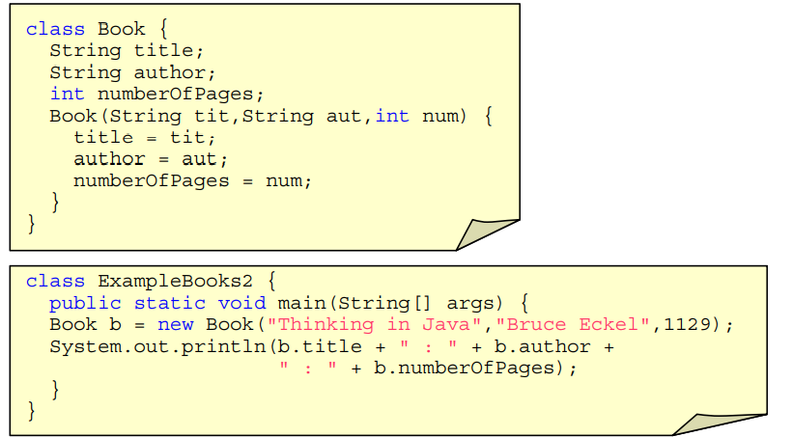
Example on Parameterized Constructors

Slide 10
ADDING Constructors for Vehicle Class
class Vehicle{
int passengers;
int fulecap;
int mpg;
Vehicle(int p,int f, int m) { //constructor for Vehicle
passangers=p;
fuleCap=f;
mpg=m; }
//Return the range
int range(){
return mpg*fuleCap; }
//compute fule needed for a given distance.
double fuleNeeded(int miles){
return(double) miles/mpg; }
}
class VehicleConstructorDemo{
public static void main(String[] args){
Vehicle minivan= new Vehicle(7, 16, 21);
Vehicle sportscar= new Vehicle(2, 14, 12);
double gallons;
int dist =252;
gallons=minivan.fuleNeeded(dist);
System.out.println(“To go ”+ dist + “miles minivan needs” + gallons + ”gallons of fule”);
gallons=sportscar.fuleNeeded(dist);
System.out.println(“To go ”+ dist + “miles sportscar needs” + gallons + ”gallons of fule”);
}

Slide 11
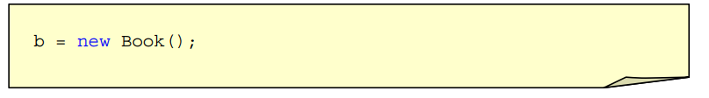
Default Constructor
Java provides a default constructor for the classes
default constructor is only available when no constructor are defined for the class.

Slide 12
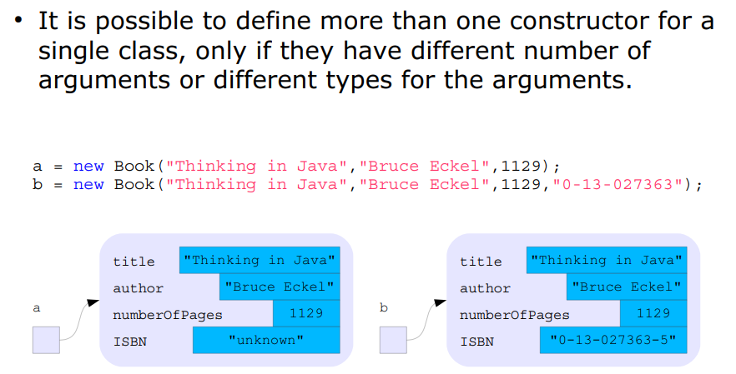
Multiple Constructor

Slide 13
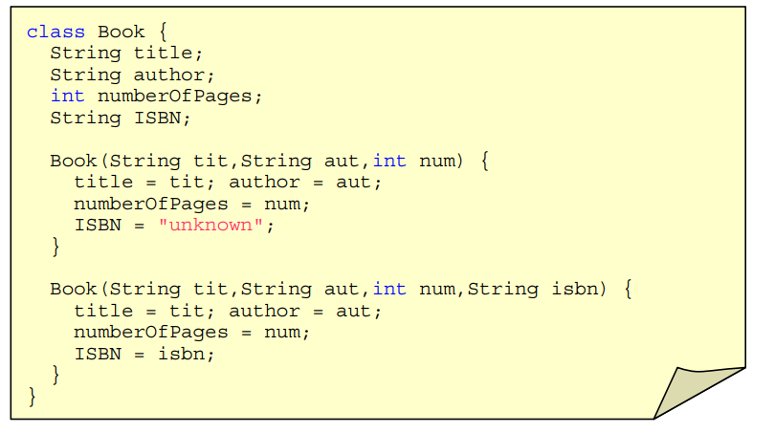
Multiple Constructor

Slide 14
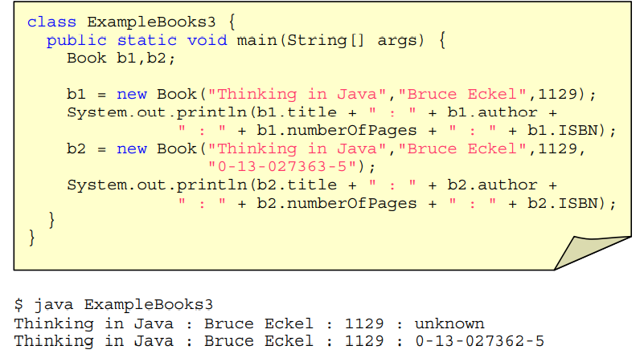
Multiple Constructor

Slide 15
the new operator revisited
The "new" operator in Java is used to create an instance of an object.
It creates an object on the heap memory and returns a reference to that object.
The new operator is followed by a constructor of the class, and it creates an instance of the class with the specified arguments.
Syntax:
class_name object_name = new class_name(arguments);
Example:
Person person1 = new Person("John Doe", 25);
In the example above, "Person" is the class name, "person1" is the object name, and "new Person("John Doe", 25)" is the constructor with arguments.

Slide 16
garbage collection and finalizers
A you have seen objects are dynamically allocated from a pool of free memory by using the new operator.
Memory is not infinite, and free memory can be exhausted, hence memory has to be freed after its usage.
In Java, garbage collection is a mechanism that automatically frees objects that are no longer being used by the program,
It work like this: When no references to an object exist that object is assumed to be no longer needed, and the memory occupied by the object is released . This memory can then be used for a subsequent allocation.
The garbage collector will usually run only when two conditions are met:
There are objects to recycle, and there is a need to recycle them..

Slide 17
The Finalize() Method
Finalizers are a mechanism for releasing resources associated with an object before it is garbage collected. Ie finializer will be called just before an object’s final destruction by the garbage collector.
They are implemented as a method called "finalize()", and it can be used in very specialized cases to ensure that object terminates cleanly.
However, the use of finalizers is generally discouraged because they can make it difficult to predict when resources will be released, and they can lead to performance problems if not used carefully.

Slide 18
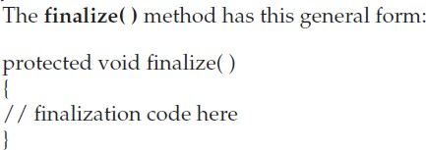
To add a finalizer to a class, you simply define the finalize( ) method.
The Java run time calls that method whenever it is about to recycle an object of that class. Inside the finalize( ) method, actions that must be performed before an object is destroyed will be specified.
The garbage collector runs periodically, checking for objects that are no longer referenced by any running state or indirectly through other referenced objects
The keyword protected is a specifier that prevents access to finalize( ) by code defined outside its class
It is important to understand that finalize( ) is only called just prior to garbage collection.
It is not called when an object goes out-of-scope, for example. This means that you cannot know when—or even if—finalize( ) will be executed

Slide 19
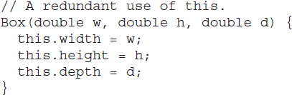
The this Keyword
this keyword can be used inside any method to refer to the current object. That is, this is always a reference to the object on which the method was invoked
The use of this is redundant, but perfectly correct. Inside Box( ), this will always refer to the invoking object. While it is redundant in this case, this is useful in other contexts

Slide 20
The this Keyword cont…
The this Keyword:
It is used to refer the current object.
It is a reference to an object.
It is used to resolve any Namespace collision between instance variables & local variables.
In java , you can have local variables including formal parameters to method to overlap. When this is the case, local variables hide the instance variables.
The problem of instance variable hiding can be overcome by the use of this keyword.

Slide 21
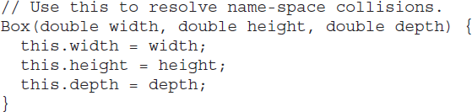
Instance Variable Hiding
It is illegal in Java to declare two local variables with the same name inside the same or enclosing scopes
Interestingly, you can have local variables, including formal parameters to methods, which overlap with the names of the class’ instance variables
When a local variable has the same name as an instance variable, the local variable hides the instance variable
For example, here is another version of Box( ), which uses width, height, and depth for parameter names and then uses this to access the instance variables by the same name
Use this to overcome the instance variable hiding

Slide 22
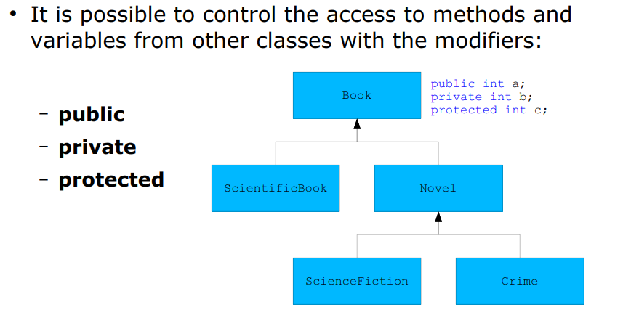
Controlling access to class members

Slide 23
Controlling Access to Class Members
As you know, encapsulation links data with the code that manipulates it. However, encapsulation provides another important attribute: access control.
How a member can be accessed is determined by the access specifier that modifies its declaration.
Java supplies a rich set of access specifiers. Some aspects of access control are related mostly to inheritance or packages. (A package is, essentially, a grouping of classes.)
Member access control is achieved through the use of three access specifiers/modifiers are public, private, and protected. Java also defines a default access level. protected applies only when inheritance is involved
When a member of a class is modified by the public specifier, then that member can be accessed by any other code
When a member of a class is specified as private, then that member can only be accessed by other members of its class.
For example,

Slide 24
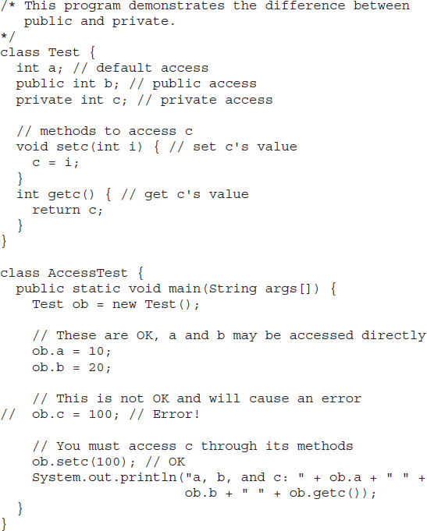
Member c is given private access. This means that it cannot be accessed by code outside of its class. So, inside the AccessTest class, c cannot be used directly. It must be accessed through its public methods: setc( ) and getc( )

Slide 25
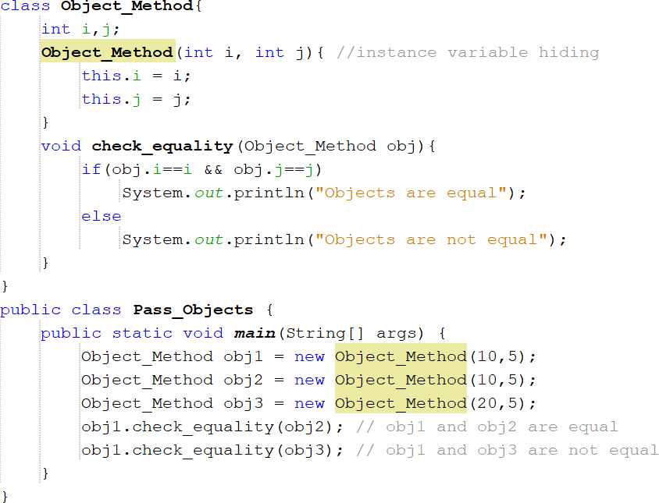
Pass Objects to Methods
So far, we have only been using primitive types such as int as parameters to methods. However, it is both correct and common to pass objects to methods.
For example,
Output:
Objects are equal
Objects are not equal
The check_equality( ) method inside Object_Method compares two objects for equality and displays the result. That is, it compares the invoking object with the one that it is passed. If they contain the same values, then the method displays objects are equal. Otherwise, it displays objects are not equal

Slide 26
How Arguments are Passed
There are two ways in which an argument can be passed to a subroutine/method
Call-by-value:
Copies the value of an argument into the formal parameter of the subroutine.
Therefore, changes made to the parameter of the subroutine have no effect on the argument.
Call-by-reference:
Reference to an argument (not the value of the argument) is passed to the parameter
Inside the subroutine, this reference is used to access the actual argument specified in the call. Changes made to the parameter will affect the argument used to call the subroutine.

Slide 27
//Call by value and call by reference.
class a{
int a=5;
int b=7;
int sum(int c , int d)//meathod header
{
int e= c+d;
return e;}
void add(int f int g)
{
System.out.print(“sum=“+(f+g));
} }
class b{
public static vid main(String[] args){
a ob=new a();
int h= ob.sum(15,10);//call by value
System .out.println(h);
Ob.add(ob.a,ob.b);//call by reference
} }

Slide 28
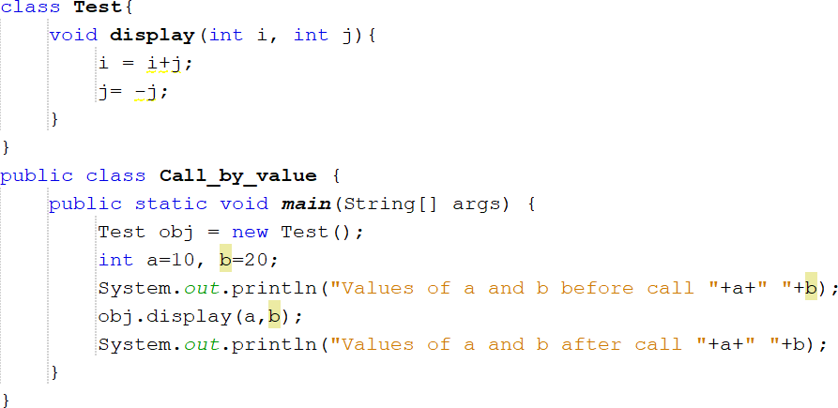
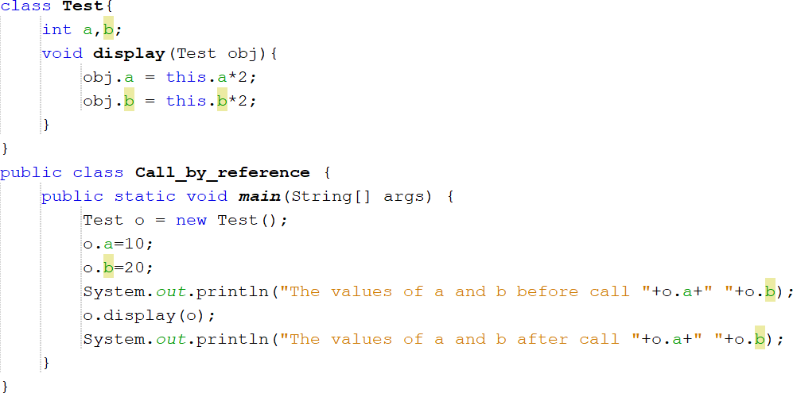
Example for call-by-value
Output:
Values of a and b before call 10 20
Values of a and b after call 10 20
The operations that occur inside display( ) have no effect on the values of a and b used in the call; their values here did not change to 30 and -20.
Example for call-by-reference
Output:
Values of a and b before call 10 20
Values of a and b after call 20 40
In this case, the actions inside display( ) have affected and changed the actual object used as an argument, as copy of the reference (not the value) is passed as the argument. Hence, the reference variables o and obj are referring to the same object.

Slide 29
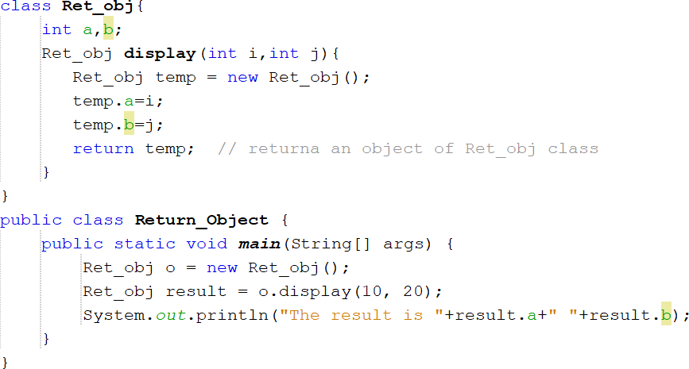

Returning Objects
A method can return any type of data, including class types that you create.
For example
When display( ) method is invoked, it returns an object of the class Ret_obj class

Slide 30
Like any other data datatype, a method can returns object. For example, in the following program, the makeTwice( ) method returns an object in which the value of instance variable is two times than it is in the invoking object.
/** * This program demonstrates how a method can return * a reference to an object. */
public class Sample {
private int value;
public Sample(int i) {
value = i; }
/** * The makeTwice method returns a Sample object * containing the value twice the passed to it. */
public Sample makeTwice() {
Sample temp = new Sample(value * 2);
return temp; }
public void show() {
System.out.println("Value : " + value); } }

Slide 31
//Program (ReturnObjectDemo.java)
public class ReturnObjectDemo {
public static void main(String[] args) {
Sample obj1 = new Sample(10);
Sample obj2;
// The makeTwice method returns a reference
obj2 = obj1.makeTwice();
obj2.show();
}
}
Output :
Value : 20

Slide 32
Method Overloading
In Java it is possible to define two or more methods within the same class that share the same name, as long as their parameter declarations are different.
When this is the case, the methods are said to be overloaded, and the process is referred to as method overloading.
Method overloading is one of the ways that Java supports polymorphism
When an overloaded method is invoked, Java uses the type and/or number of arguments as its guide to determine which version of the overloaded method to actually call
Thus, overloaded methods must differ in the type and/or number of their parameters.
When Java encounters a call to an overloaded method, it simply executes the version of the method whose parameters match the arguments used in the call.

Slide 33
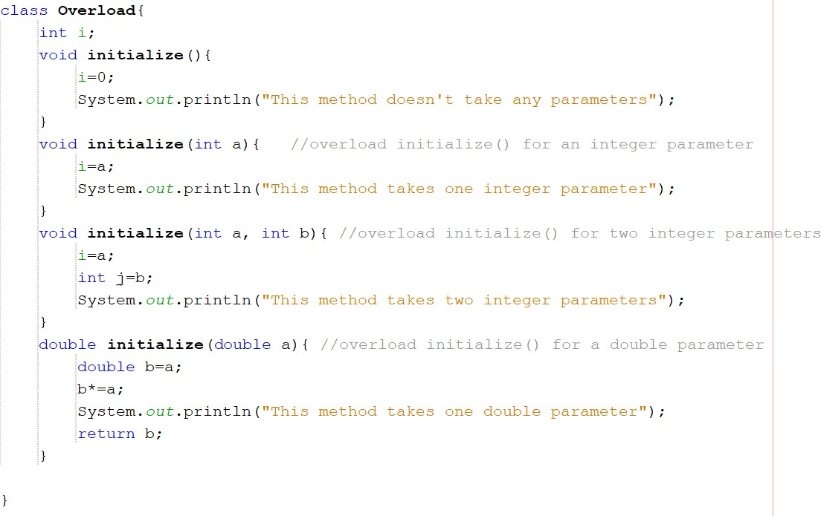
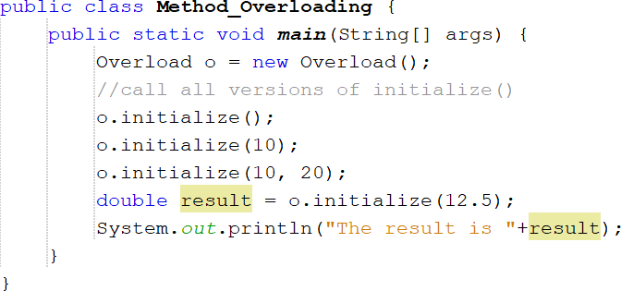
Output:
This method doesn't take any parameters This method takes one integer parameter This method takes two integer parameters This method takes one double parameter The result is 156.25
initialize( ) is overloaded four times

Slide 34
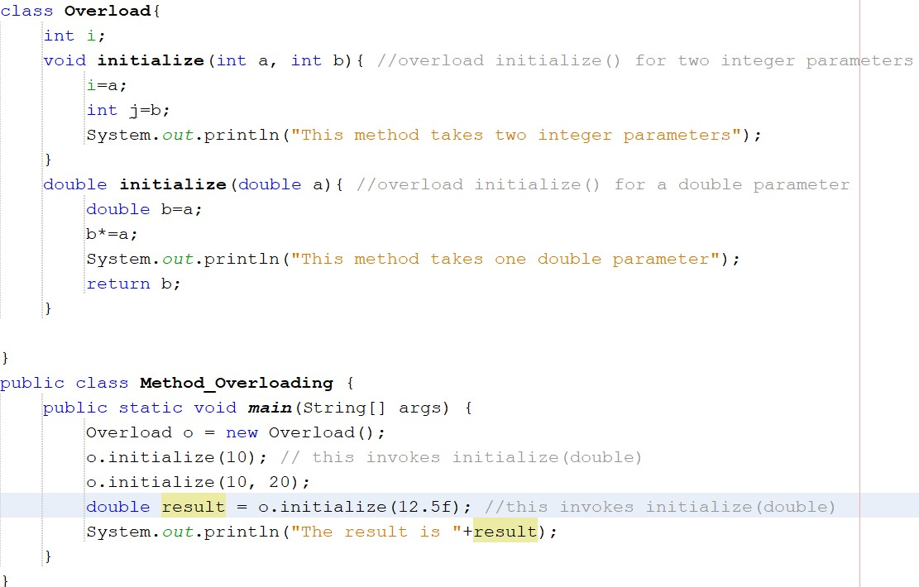
In some cases, Java’s automatic type conversions can play a role in overload resolution.
Output:
This method takes one double parameter
This method takes two integer parameters
This method takes one double parameter
The result is 156.25

Slide 35
5a) Write a program to demonstrate the implementation of method overloading
5.1) Create a Stack class having an integer array say elem and top_of_stack as instance variables. Define three overloaded methods having the following signatures:
a. initStack(int size) to create an array of specified size and initialize the top_of_stack
b. initStack(Stack another) to intialize the Stack object with state of the Stack object "another"
c. initStack(int [] a) to initialize contents of a[] to the instance variable elem.
Write following methods:
a. push(): Pushes the element onto the stack,
b. pop(): Returns the element on the top of the stack, removing it in the process, and
c. peek(): Returns the element on the top of the stack, but does not remove it.
Also write methods that check whether stack is full and stack is empty and return boolean value true or false appropriately.

Slide 36
class Stack{
int[] ele;
int top;
void initStack(int size){
ele=new int[size];
top=-1;
}
void initStack(Stack another){
ele=new int[another.ele.length];
top=-1;
for(int item:another.ele)
push(item);
}
void initStack(int[] a){
ele=new int[a.length];
top=-1;
for(int item:a)
push(item);
}
void push(int item){
if(top<ele.length){
ele[++top]=item;
System.out.println("Pushed element is "+item);
}
else
System.out.println("Stack overflow");
}
int pop(){
if(top==-1){
System.out.println("Stack underflow");
return -1;
}
else{
int item=ele[top--];
return item;
}
}
int peek(){
return ele[top];
}
}

Slide 37
public class TW5a {
public static void main(String[] args) {
Stack s1=new Stack();
Stack s2=new Stack();
s1.initStack(5);
s1.push(10);
s1.push(20);
s1.push(30);
s1.push(40);
s1.push(50);
s2.initStack(s1);
int[] array={1,2,3,4};
Stack s3=new Stack();
s3.initStack(array);
System.out.println("Popped element in S1 object is "+s1.pop());
System.out.println("Element on top of the stack of object s1 is "+s1.peek());
System.out.println("Element on top of the stack of object s2 is "+s2.peek());
}
}

Slide 38
5 b) Overriding.
5 b.1 )Implement the following class hierarchy. In the Cuboid class, override the method computeArea() and computePerimeter() of Rectangle class to compute the surface area and perimeter of a rectangle cuboid. Add a method computeVolume() in Cuboid class to compute volume of the cuboid. Assuming length, width and height as l, w and h respectively,
formula to find the surface area = 2(lw) + 2(hl) + 2(hw)
formula to find the perimeter = 2l + 2w
formula to find the volume = l x w x h

Slide 39
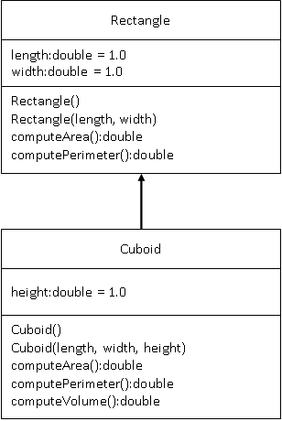

Slide 40
class Rectangle {
double length;
double width;
Rectangle() {
length = 1.0;
width = 1.0;
}
Rectangle(double length, double width) {
this.length = length;
this.width = width;
}
double computeArea() {
return length * width;
}
double computePerimeter() {
return 2 * (length + width);
}
}
class Cuboid extends Rectangle {
double height;
Cuboid() {
super();
height = 1.0;
}
Cuboid(double length, double width, double height) {
super(length, width);
this.height = height;
}
@Override
double computeArea() {
return 2 * ((length * width) + (width * height) + (length * height));
}
@Override
double computePerimeter() {
return 4 * (length + width + height);
}
double computeVolume() {
return length * width * height;
}
}

Slide 41
public class TW5b{
public static void main(String[] args) {
Rectangle r1 = new Rectangle();
System.out.println("Rectangle 1:");
System.out.println("Area:" + r1.computeArea());
System.out.println("Perimeter:" + r1.computePerimeter());
Rectangle r2 = new Rectangle(10,30);
System.out.println("\nRectangle 2:");
System.out.println("Area:" + r2.computeArea());
System.out.println("Perimeter:" + r2.computePerimeter());
Cuboid c1=new Cuboid();
System.out.println("\nCuboid 1:");
System.out.println("Area:" + c1.computeArea());
System.out.println("Perimeter:" + c1.computePerimeter());
System.out.println("Volume:" + c1.computeVolume());
Cuboid c2=new Cuboid(10,30,40);
System.out.println("\nCuboid 2:");
System.out.println("Surface area:" + c2.computeArea());
System.out.println("Perimeter:" + c2.computePerimeter());
System.out.println("Volume:" + c2.computeVolume());
}
}

Slide 42
Previous Year Question for reference..
Q1. Explain with examples the following terms.
this
finialize() method
returning objects.
Q2. Define constructors.Demonstrate the concept of constructor overloading with an example.
Q3.

Slide 43
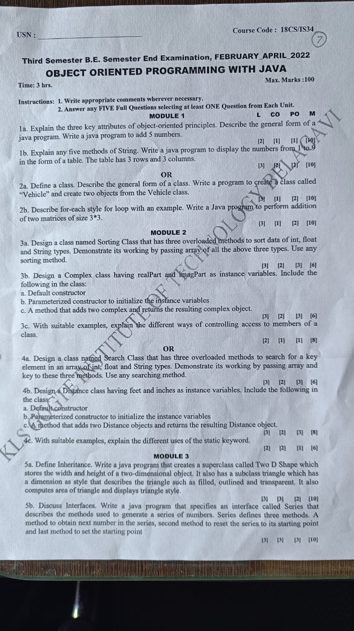

Slide 44
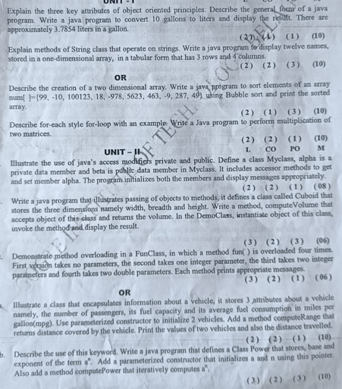

Slide 45
